Slide 1
Blind Test of Healthy and Head & Neck Cancer Samples via PANORAMA

Slide 2
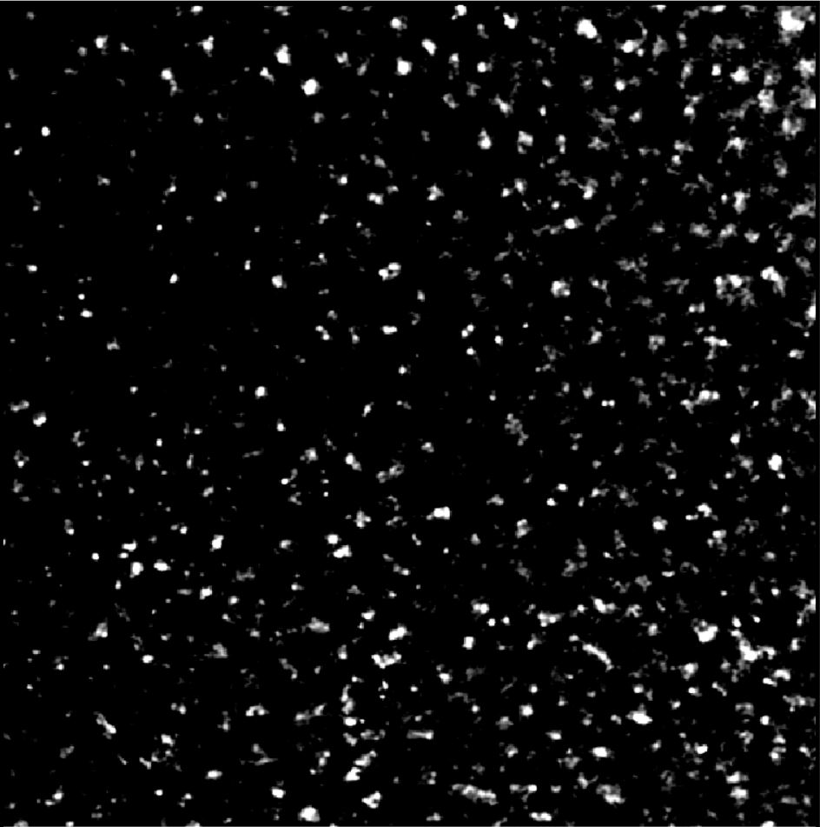

Image of Detected Particles via PANORAMA (33)
Time: 60 min
Count: 510 (Ex: 406; Large: 104)
Time: 60 min wash
Count: 105
Note: 0 % response to miRNA-21
Look cancerous
Note: Before wash count matches CI of stage 3 (500-1200)
After wash count lower end CI for stage 3 (155-304)
Scale Bar: 10 µm

Slide 3
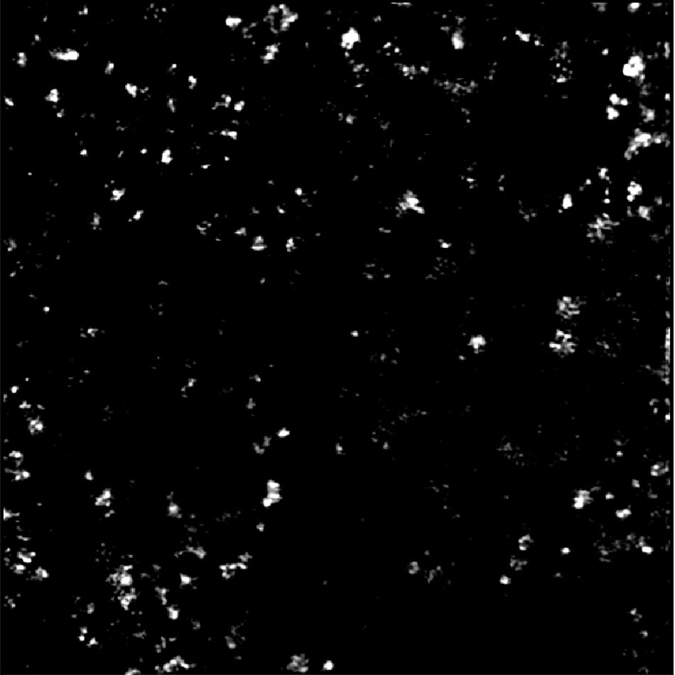

Image of Detected Particles via PANORAMA (34)
Time: 60 min
Count: 298 (Ex: 241; Large: 57)
Time: 60 min wash
Count: 93
Note: 0 % response to miRNA-21
Look cancerous
Note: Before wash count lower than CI of stage 3 (500-1200)
After wash count lower end CI for stage 3 (155-304)
Scale Bar: 10 µm

Slide 4
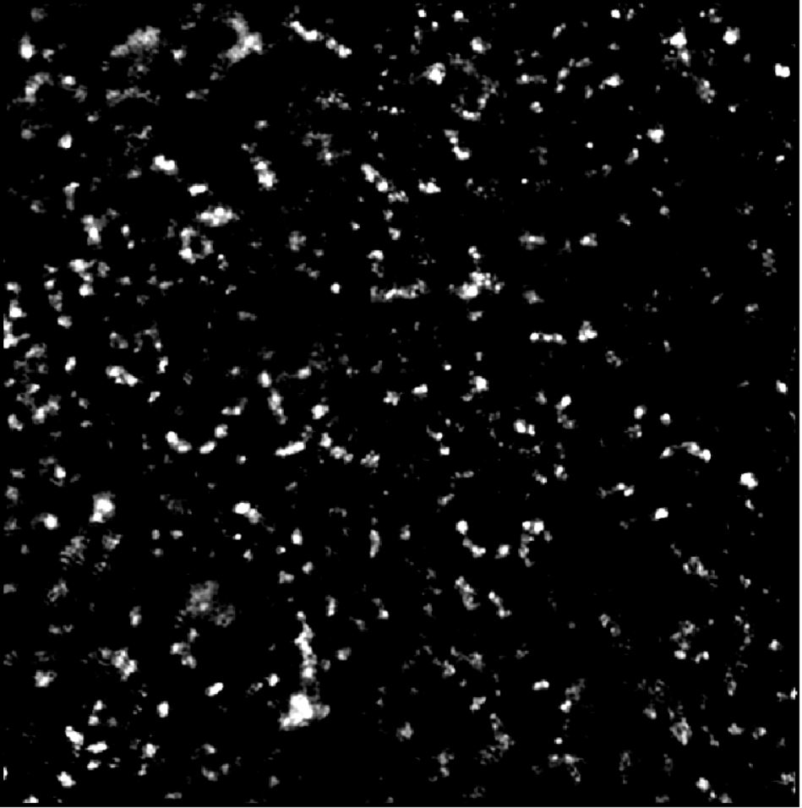

Image of Detected Particles via PANORAMA (35)
Time: 60 min
Count: 526 (Ex: 396; Large: 130)
Time: 60 min wash
Count: 99
Note: 0 % response to miRNA-21
Look cancerous
Note: Before wash count matches CI of stage 3 (500-1200)
After wash count lower end CI for stage 3 (155-304)
Scale Bar: 10 µm

Slide 5
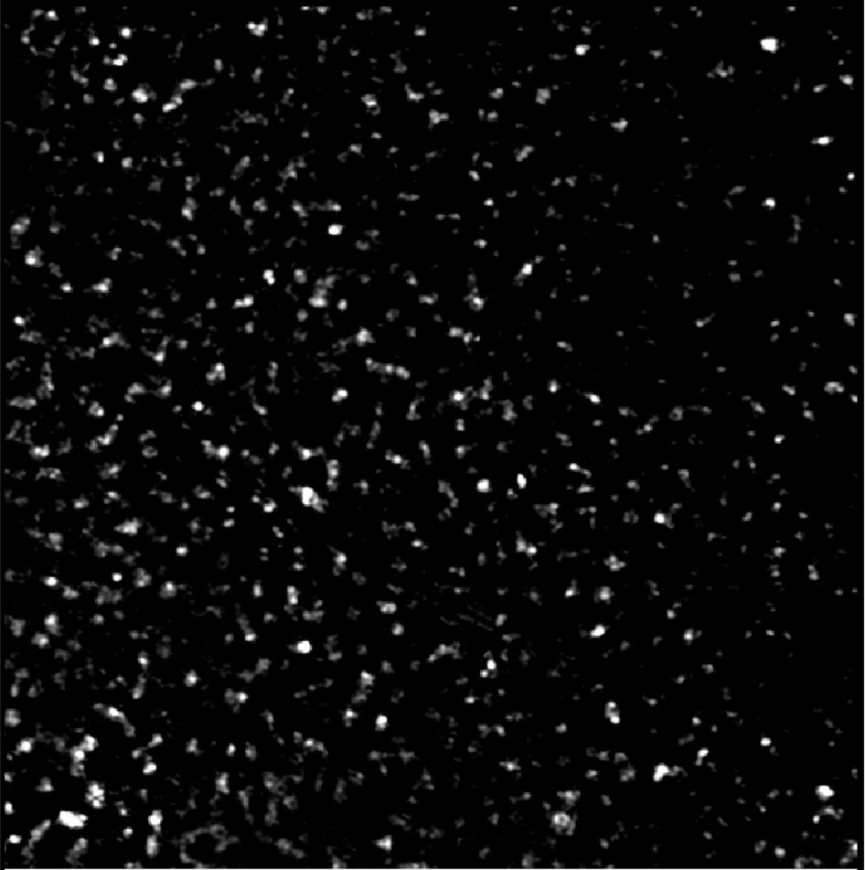

Image of Detected Particles via PANORAMA (42)
Time: 60 min
Count: 753 (Ex: 626; Large: 127)
Time: 60 min wash
Count: 123
Note: 0 % response to miRNA-21
Look cancerous
Note: Before wash count matches CI of stage 3 (500-1200)
After wash count lower end CI for stage 3 (155-304)
Scale Bar: 10 µm

Slide 6
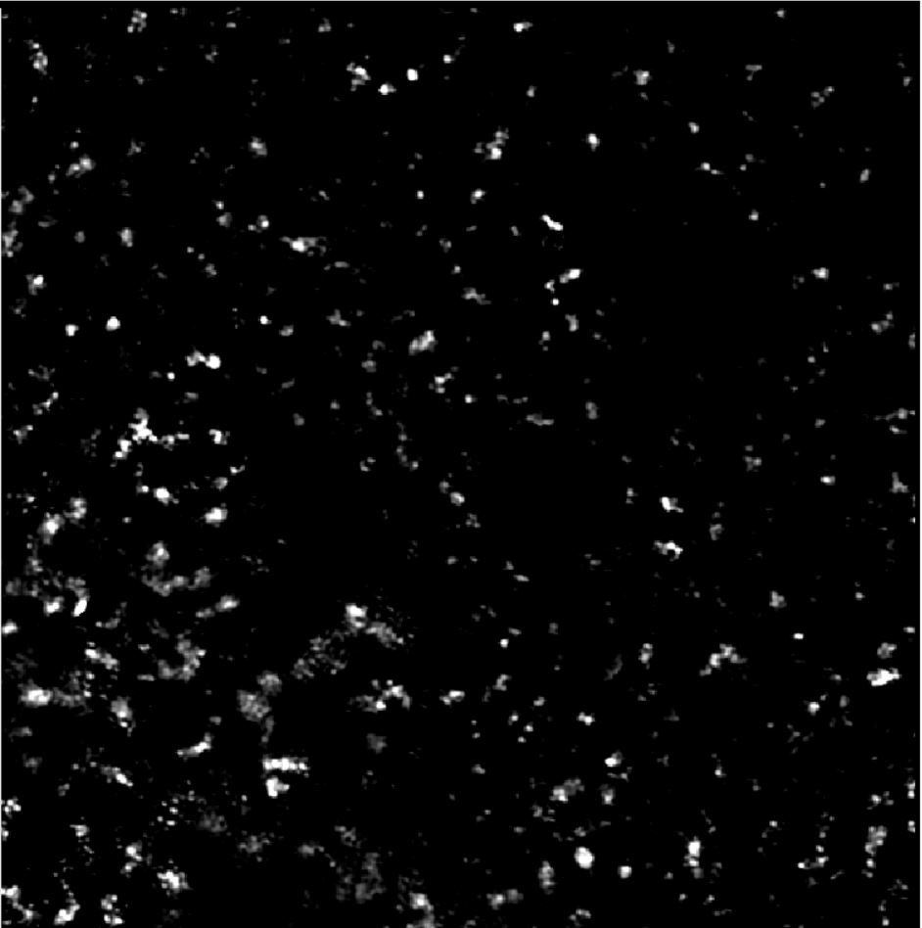

Image of Detected Particles via PANORAMA (43)
Time: 60 min
Count: 397 (Ex: 308; Large: 89)
Time: 60 min wash
Count: 20
Note: Before wash count lower than CI of stage 3 (500-1200)
After wash count lower than CI for stage 3 (155-304)
Note: 0 % response to miRNA-21
Looks Healthy
Scale Bar: 10 µm

Slide 7
Summary
Note: Healthy Patient Count: 5-75
Patient | Total Particles | Large Particles | Exosomes like particles | Retained Exosomes | mir-21% | Retention Rate,% (Retained Exosome/Exosome like particles) | Prediction
11 | 369 | 138 | 231 | 34 | 0 | 14.7 | Healthy
12 | 398 | 117 | 281 | 35 | 0 | 12.45 | Healthy
13 | 352 | 86 | 266 | 81 | 0 | 30.45 | Cancerous
14 | 148 | 55 | 93 | 13 | 0 | 13.9 | Healthy
15 | 428 | 138 | 290 | 85 | 11.5 | 29.3 | Cancerous
16 | 264 | 78 | 186 | 21 | 0 | 11.3 | Healthy
17 | 381 | 143 | 238 | 23 | 0 | 9.66 | Healthy
24 | 249 | 110 | 139 | 31 | 0 | 22.3 | Healthy
25 | 320 | 85 | 235 | 120 | 0 | 51.1 | Cancerous
33 | 510 | 104 | 406 | 105 | 0 | 25.86 | Cancerous
34 | 298 | 57 | 241 | 93 | 0 | 38.6 | Cancerous
35 | 526 | 130 | 396 | 99 | 0 | 25 | Cancerous
42 | 753 | 127 | 626 | 123 | 0 | 19.7 | Cancerous
43 | 397 | 89 | 308 | 20 | 0 | 6.5 | Healthy

